Slide 1

Fundamentals of Computational Physics
徐长松
物理学系
群二维码
Email：csxu@fudan.edu.cn
微信：xuchs07
办公室：新江湾校区物理楼S110/交叉一号楼A4009
主页：http://www.cps.fudan.edu.cn/xugroup

Slide 2
助教：辛在舟（物理系）
email：xinzz19@fudan.edu.cn
手机： 19821227815
助教：陈英炜（物理系）
email: yingweichen21@m.fudan.edu.cn
手机：15026848343
微信群：计算物理基础2024
问题讨论，资源共享，通知等
答疑：微信找助教，相似的问题多了，可以腾讯会议
微信或邮件找我；课前、课后、恒隆物理楼

Slide 3
参考书
Pual L DeVries, A First Course in Computational Physics, Wiley, 1994
Tao Pang, An Introduction to Computational Physics, Cambridge University Press, 2006
Morten Hjorth-Jensen, Computational Physics, University of Oslo, 2007
Mark Newman, Computational Physics, CreateSpace Independent Publishing Platform, 2012
刘金远，计算物理学，科学出版社，2022
课件下载
http://elearning.fudan.edu.cn

Slide 4
学习成绩
平时（50％）＋ 期末（50％）
平时成绩：上课情况，回答问题情况，作业（编程，eLearning电子版），小测验（纸质）
每个作业、测验100分，逾期扣10分来算的
期末：闭卷（半开卷，待定）考试

Slide 5
Notes on home work
• No copy-paste!!!
• Format of home work (electronic version, pdf or word)
Describe the problem and your method to solve the problem in details
Give the pseudo-code of your program
Give some inputs to your real program and discuss the outputs (e.g., using tables or plots). Sometimes you may need to explain the results.
Also provide the source code (use as much comments as possible) and a simple manual (inputs and outputs)

Slide 6
Syllabus of this course
Introduction of computational physics
Basics of Fortran and Linux
Find roots of an equation
Numerical methods for matrices
Interpolation and approximation
Numerical differentiation and integration
Fourier transform
Solve ordinary differential equations
Solve partial differential equations
Monte Carlo simulations
Basics of machine learning
Notes:
本课程大纲
计算物理学简介
Fortran 和 Linux 基础
求解方程的根
矩阵的数值方法
插值和逼近
数值微分和积分
傅里叶变换
求解常微分方程
求解偏微分方程
蒙特卡洛模拟
机器学习基础

Slide 7
Introduction
Brief history of computers
Supercomputers
Importance of computational physics
Course plan

Slide 8

Birth of Computational Science (Physics)
The first electronic general-purpose computer:
Constructed in Moore School of Electrical Engineering, University of Pennsylvania, 1946
ENIAC: Electronic Numerical Integrator And Computer

Slide 9
ENIAC Electronic Numerical Integrator And Computer
Design and construction was financed by the United States Army.
Designed to calculate artillery firing tables for the United States Army's Ballistic Research Laboratory.
It was heralded in the press as a "Giant Brain".
It had a speed of one thousand times that of electro-mechanical machines.
ENIAC was named an IEEE (电气电子工程师学会) Milestone in 1987.

Slide 10
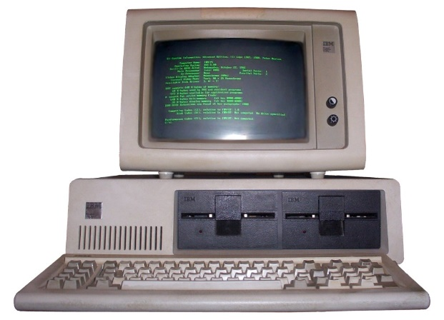
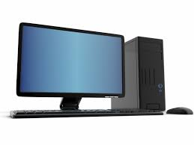

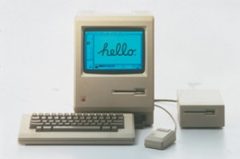
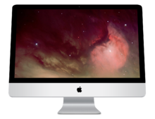
Development of micro-computers
modern PC
CPU: Intel i3,i5,i7, 3 GHz
Solid state disk
1981 IBM PC 5150
CPU: 8088, 5 MHz
Floppy disk or cassette
1984 Macintosh
Steve Jobs
modern iMac

Slide 11
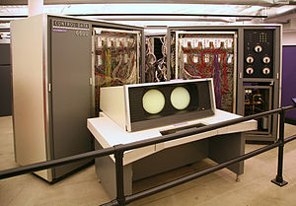
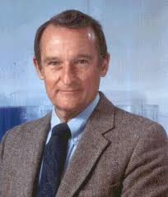
Supercomputers
The CDC (Control Data Corporation) 6600, released in 1964, is generally considered the first supercomputer.
Seymour Roger Cray (1925-1996)
The father of supercomputing, who created the supercomputer industry.

Slide 12
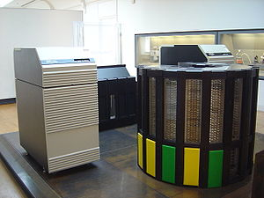
Cray Inc.
Cray I 1976-1981
Cray II 1985-1989
......
Cray XT5 2009-2010
Cray XK7 2012-2013
Cray-2, the fastest computer between 1985 and 1989.

Slide 13
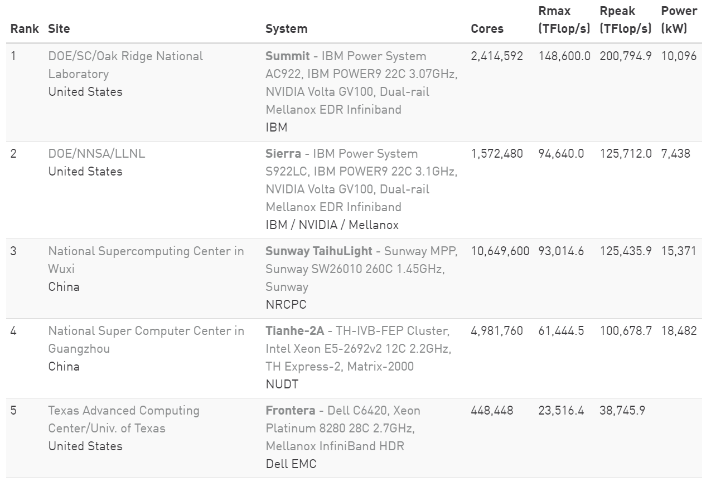
Top 5 supercomputers
http://www.top500.org/

Slide 14
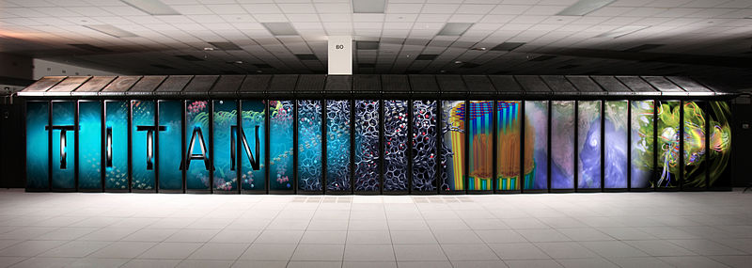
Supercomputer- Titan, since Oct. 29, 2012
Sponsor US DOE Operators Cray Inc.
Location Oak Ridge National Laboratory
Architecture 18,688 AMD Opteron 6274 16-core CPUs +18,688 Nvidia Tesla K20X GPUs
Cray Linux Environment
Power 8.2 MW Space 404 m²
Memory 710 TB Storage 10 PB
Cost US$ 97 million Purpose Scientific research

Slide 15
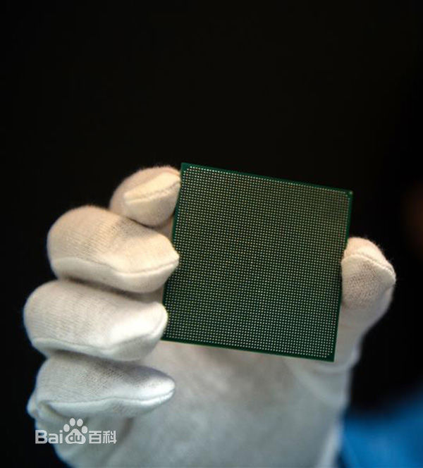
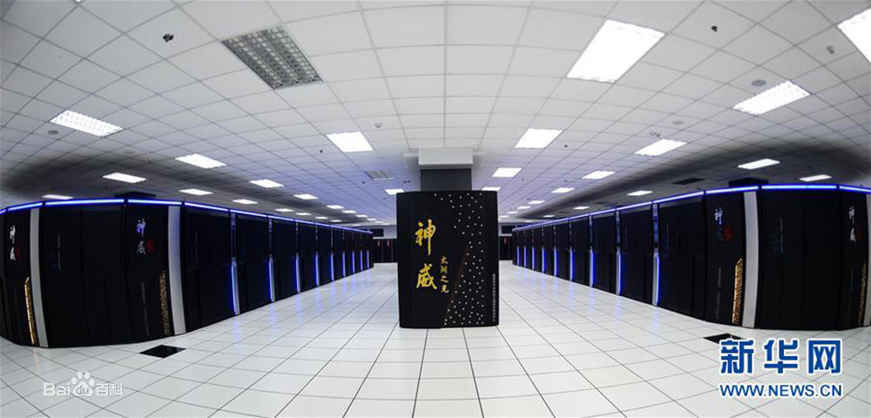
Sunway-Taihulight
40,960 CPUs, 10,649,600 cores
originated from DEC Alpha 21164
Reduced Instruction Set Computer (RISC)
1.5GHz

Slide 16
Applications of Computational Science
Dynamics of the global environment, weather forecasting
Molecular dynamics simulation; design of drugs, materials and devices
Simulation of weapons
Cartoon, 3D movies, multimedia
Simulation of finance, traffic, society ......
......
All above applications are related to computational physics!

Slide 17
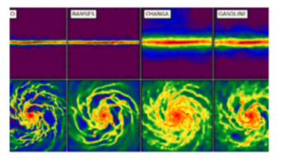
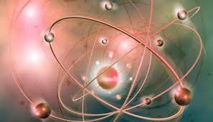
Topics of computational physics
Cosmology
Quantum physics
Statistical physics
Condensed matter physics

Slide 18
Computation across all areas of physics
High Energy Physics: lattice chromodynamics, theory of the strong interaction, data analysis from accelerator experiments
Astronomy and Cosmology: formation and evolution of solar systems, star systems and galaxies
Condensed Matter Physics: - electronic structure of solids and quantum effects - nonlinear and far from equilibrium processes - properties and dynamics of soft materials such as polymers, liquid crystals, colloids
Biophysics: simulations of structure and function of biomolecules such as proteins and DNA
Materials Physics: behavior of complex materials, metals, alloys, composites

Slide 19

Computational condensed-matter physics
atoms
Equation of state
Electromagnetic properties
Mechanical properties
Structures
Optical properties
。。。。。
electrons
Structure
Temperature
Pressure
Shrödinger Eq.
Maxwell’s Eq.
Newton Eq.
Boltzmann Eq.

Slide 20
What is "computational physics"?
1. Process and analyze large amounts of data from measurements; fit to theoretical models; display and animate graphically Ex: search for "events" in particle physics, image analysis in astronomy.
2. Numerical solution of equations that cannot be accomplished by analytical techniques (coupled, nonlinear etc.) Ex: fluid dynamics (Navier Stokes), numerical relativity (Einstein's field equations), electronic ground state wave functions in solid state systems, nonlinear growth equations
3. Computer "experiments": simulate physical phenomena, observe and extract quantities as in experiments, explore simplified model systems for which no solution is known. Ex: molecular simulations of materials, protein folding, planetary dynamics (N-body dynamics).

Slide 21
How is it done?
"Small simulations" on workstations; Program with numerical packages such as Maple/Matlab/Mathematica or in high-level programming languages such as C/C++ or Fortran
"Large simulations" on computer clusters or supercomputers; may require lots of memory or calculation time distribute the problem over many (~10 to 1000) processors either separately or "in parallel"
Grid computing: networks of supercomputing centers dedicated to scientific problems, spatially separated

Slide 22
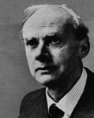
Why Computational Physics?
“The general theory of quantum mechanics is now almost complete. The underlying physical laws necessary for the mathematical theory of a large part of physics and the whole of chemistry are thus completely known, and the difficulty is only that the exact application of these laws leads to equations much too complicated to be soluble.”
Dirac, 1929

Slide 23
Why is computational physics important?
There is no exact analytical solution for a many-body problem！
only a two-body problem can be solved analytically.
other general methods for many-body problems involve approximations with uncontrolled errors！
《三体》

Slide 24
Why is computational physics important?
Uncontrolled approximations always breakdown somewhere.
test out or benchmark approximate methods
find their range of validity.
exactness of simulation is very important!
otherwise, wasting computer and human time.

Slide 25
Why is computational physics important?
Why not just measure properties in the lab?
reliable predictions when experiments are
not possible or very difficult, or very expensive.
Some examples: materials phase transitions under extremely high pressure, nuclear reaction, car collision, etc.

Slide 26
Why is computational physics important?
Interesting to study artificial models to gain insight into the limitations of theory.
For example: how do phase transitions change in going from 2 to 3 to 4 dimensions?

Slide 27
Why is computational physics important?
A third way of doing science, comparable to theory and experiment.
Simulations do have both theoretical and experimental aspects.
Simulations have become so important that all scientists should learn its fundamentals.

Slide 28
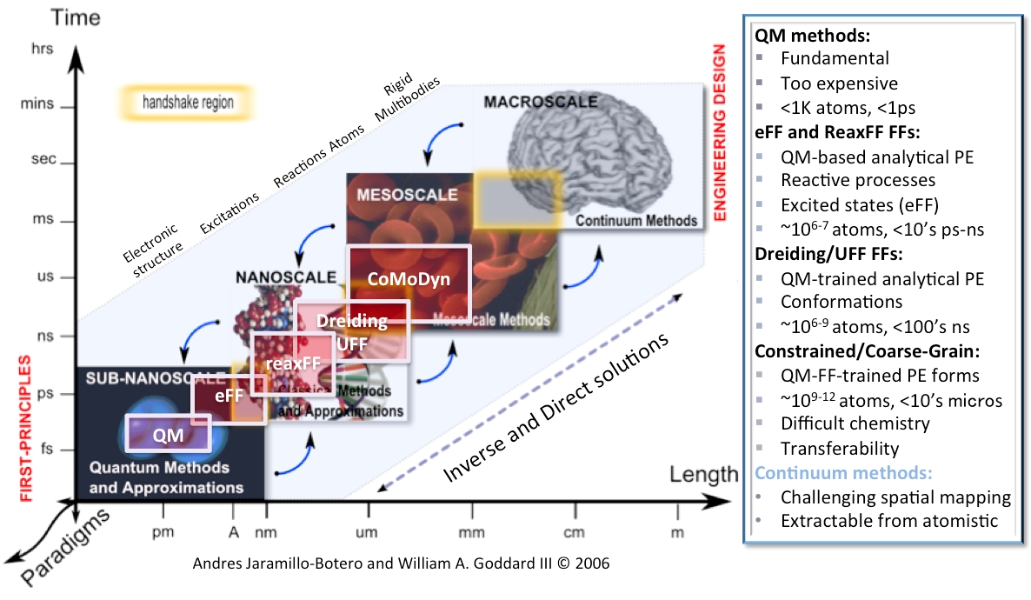
Why is computational physics important?
Simulations scale up with the increase of computer power. The earliest simulations involved 32 particles; now one can do millions of particles (or more!).

Slide 29
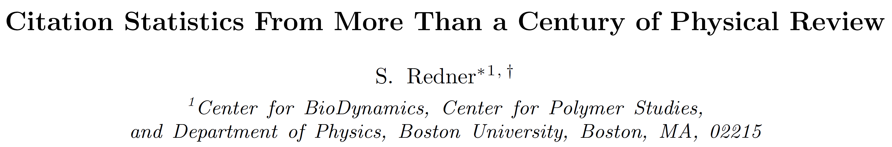
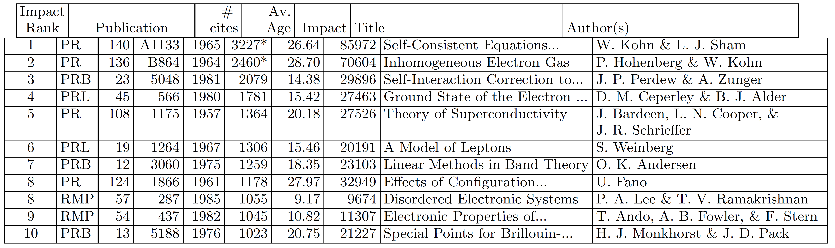
Why is computational physics important?
arXiv:physics/0407137
√
√
√
√
√
√
Top-10 cited Physical Review articles

Slide 30
Theory - Computation - Experiment
Computational Physics
Performs idealized "experiments" on the computer, solves physical models numerically
predicts
tests
tests
predicts
predicts
Theoretical Physics
Construction and mathematical (analytical) analysis of idealized models and hypotheses to describe nature
tests
Experimental Physics
Quantitative measurement of physical phenomena

Slide 31
How does the computational physicist work?
Devise and implement a computer model for the physical question of interest
Needs numerical mathematics toolkit: discretization, error analysis, stability, efficiency
Perform the computation
Analyze and visualize the data
Interpret and compare to experiment and theory
Improve model predictions
Notes:
计算物理学家是如何工作的？
设计和实现一个计算机模型，以解决感兴趣的物理问题
需要数值数学工具包：离散化、误差分析、稳定性、效率
执行计算
分析和可视化数据
解释并与实验和理论进行比较
改进模型预测

Slide 32

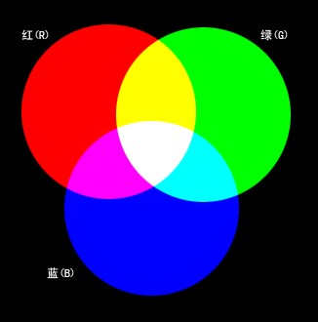
What will be studied?
A cup of cocktail:
Computer science
Mathematics
Physics
It may not be the most important course, but maybe the most useful course!

Slide 33

The aim of this course
To Learn how to establish efficient and accurate algorithms as well as how to write clean and structured computer programs for most problems encountered in physics and related fields.

Slide 34
Syllabus of this course
Introduction of computational physics
Basics of Fortran and Linux
Find roots of an equation
Numerical methods for matrices
Interpolation and approximation
Numerical differentiation and integration
Fourier transform
Solve ordinary differential equations
Solve partial differential equations
Monte Carlo simulations
Basics of machine learning
Notes:
本课程大纲
计算物理学简介
Fortran 和 Linux 基础
求解方程的根
矩阵的数值方法
插值和逼近
数值微分和积分
傅里叶变换
求解常微分方程
求解偏微分方程
蒙特卡洛模拟
机器学习基础

Slide 35
Tools for computational physics
High-level programming languages, e.g. Fortran/C/C++.....
I usually use Fortran, you can choose C/C++ or Python.
Maple/Matlab/Mathematica: for engineers, and Symbolic computation
Operating system: I used Linux

Slide 36
Introduction to Pseudo-code
One of the popular representation of Algorithm
Widely choosen because:
easy to read and write
allow the programmer to concentrate on the logic of the problem
structured in English language
Notes:
伪代码简介
伪代码是算法的一种流行表示方法
之所以被广泛选择，是因为：
易于阅读和书写
使程序员能够专注于问题的逻辑
以英文语言为结构

Slide 37
Bad vs good pseudo-code
Bad pseudo-code
gives too many details or
is too implementation specific (i.e., actual C++ or Java code or giving every step of a sub-process such as set union)
Good pseudo-code
Is a balance between clarity and detail
Abstracts the algorithm
Makes good use of mathematical notation
Is easy to read and
Facilitates implementation (reproducible, does not hide away important information)
Notes:
糟糕的伪代码 vs 优秀的伪代码
糟糕的伪代码
过于详细，提供太多细节
或者太过依赖具体实现（例如，实际的C++或Java代码，或者详细列出子过程的每一步，如集合并集）
优秀的伪代码
在清晰度和细节之间取得平衡
抽象出算法
很好地利用数学符号
易于阅读
便于实现（可复现，不隐藏任何重要信息）
这张幻灯片对比了糟糕的伪代码和优秀伪代码的特点，强调了优秀伪代码应具备的平衡性、抽象性和可读性，同时应避免过度依赖具体编程语言的实现细节。

Slide 38
Good Pseudo-Code: Example
Intersection
Input: Two finite sets A, B
Output: A finite set C such that C = A ∩ B
C←0
If |A|>|B|
Then Swap(A,B)
End
For every x ∈ A Do
If x ∈ B
Then C ← C ∪ {x}
End
End
Return C

Slide 39
Writing Pseudo-Code: Advice
Input/output must be properly defined
All your variables must be properly initialized, introduced
Variables are instantiated, assigned using ←
All `commands' (while, if, repeat, begin, end) bold face
For i ← 1 to n Do
All functions in small caps Swap(A,B)
All constants in courier: pi ← 3.14
All variables in italic: temperature ← 78
Notes:
编写伪代码：建议
输入/输出必须正确定义
所有变量必须正确初始化和引入
变量的实例化和赋值使用 ← 符号
所有‘命令’（如 while, if, repeat, begin, end）加粗显示
例如：For i←1i \leftarrow 1i←1 to nnn Do
所有函数使用小写字母：swap(A,B)
所有常量使用等宽字体：pi ← 3.14
所有变量使用斜体：temperature ← 78
这张幻灯片给出了编写伪代码的一些建议，帮助保持伪代码的清晰性和一致性，包括如何格式化命令、变量、常量和函数。

